Slide 1

Crack Detecting Method
with YOLOv3
Team MP3

Slide 2
Overview
Project title | Crack Detecting Method with YOLOv3
Team | MP3
Participants | Wonkwang University Dohyun Kim | Sanha Choi | Kang Lee Purdue University Brandon Lee | Christian Elfreich | Evan McClain | Kichang Kang | Scott Stevens | Wes Johnston
Category | Total research period | That year
Project period | 2021.10.10 ~ 2021.12.16 | 2021.10.10. ~ 2010.12.16. ( 2 month )

Slide 3
Introduction
Footprint
Start research
Data labeling
Final presentation
Brainstorming and Select a topic
Finding related papers and materials
Drafting paper
Collecting data
Data labeling with Roboflow
Final paper submission
Mid presentation
Model design and test
Mid paper submission
Development environment setting
Using Dark net & YOLOv3 for model
Testing by combining, reducing, and increasing datasets
Model performance test while modifying the layer.

Slide 4
Agenda
Introduction
2. Literature review
3. Research method
4. Experiments
5. Conclusion

Slide 5
Literature review
1 of 3
This system collects real-time data from UAV [7].
This provides on-site utility for damage detection in dangerous or unreachable locations [7].
However, this requires having access to a pre-trained network and may be difficult to recognize less common types of building damage, such as destruction or stagnant water [8].
[7] Sankarasrinivasan, S., Balasubramanian, E., Karthik, K., Chandrasekar, U., & Gupta, R. Health monitoring of civil structures with integrated UAV and image processing system. Procedia Computer Science, vol 54. p. 508-515, 2015.
[8] Kung, R. Y., Pan, N. H., Wang, C. C., & Lee, P. C. Application of Deep Learning and Unmanned Aerial Vehicle on Building Maintenance. Advances in Civil Engineering, 2021. Y. Yorozu, M. Hirano, K. Oka, and Y. Tagawa, “Electron spectroscopy studies on magneto-optical media and plastic substrate interface,” IEEE Transl. J. Magn. Japan, vol. 2, p. 740–741, Aug. 1987 [Digests 9th Annual Conf. Magnetics Japan, p. 301, 1982.

Slide 6
Literature review
2 of 3
In terms of detecting property damage, a method which utilizes a Darknet neural network via YOLO has also been researched [9].
This can further aid in the project’s goals of detecting property damage via the use of a UAV, particularly with regards to improving the deep learning algorithm used [9].
Still, there can be challenges regarding the varying sizes and general unpredictability of cracks, so the use of deep convolutional neural networks (CNN) may allow for increased accuracy when analyzing property damage [11].
[9] H.-G. Moon and J.-H. Kim, “Intelligent crack detecting algorithm on the concrete crack image using neural network,” 28th International Symposium on Automation and Robotics in Construction (ISARC 2011), 2011.
[11] S.-suk Choi and E.-kon Kim, “Building Crack Inspection Using Small UAV,” 2015 17th International Conference on Advanced Communication Technology (ICACT), 2015.

Slide 7
Literature review
3 of 3
Using UAV for damage detection is great benefit [12].
Reduce cost
Shorten time
Lower the risk
If you use deep-learning, their effectiveness and potential would be even more realized [12].
[12] S. Carata, R. Mihaescu, E. Barnoviciu, M. Chindea, M. Ghenescu, and V. Ghenescu, “Complete Visualisation, network modeling and training, web based tool, for the Yolo Deep Neural Network model in the Darknet Framework,” 2019 IEEE 15th International Conference on Intelligent Computer Communication and Processing (ICCP), 2019.

Slide 8
Novelty
Novelty
A deep learning model is created to detect all cracks such as buildings, bridges, roads, and sidewalk blocks.
Various types of structure datasets (included custom dataset) are collected and processed for this model.

Slide 9
Goal
Project goal
Using the Darknet and YOLOv3 to create an artificial intelligence model that can detect all cracks.

Slide 10
Research method
Learning environment
Dataset
Preprosessing

Slide 11
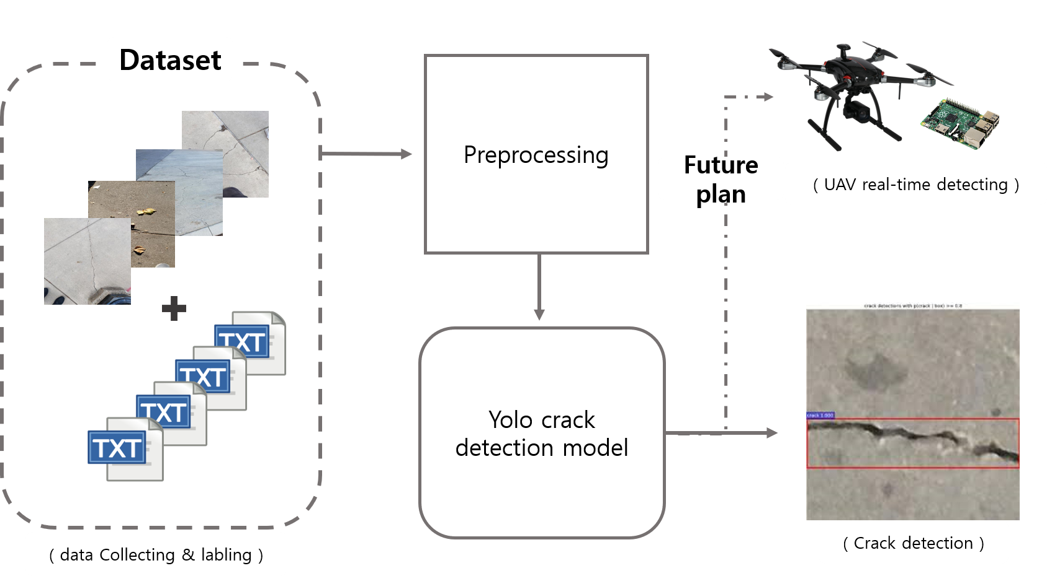
System overview
Flow chart

Slide 12
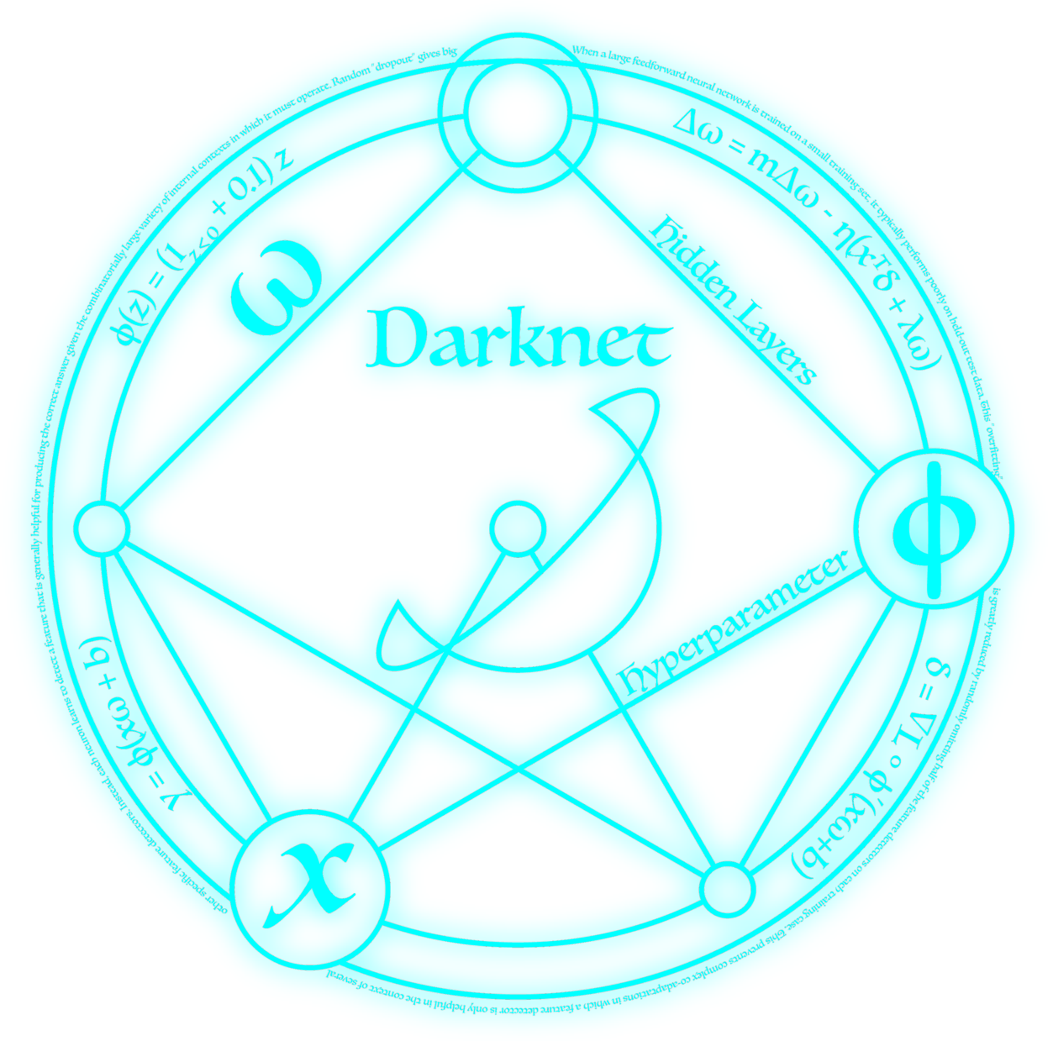

YOLO & Dark-net
Used YOLOv3 with Darknet as the deep learning framework to classify these images.
YOLOv3 is the object detection algorithm.
Darknet is the open-source neural network that allows for real-time object detection.
These were used to train the AI model .

Slide 13
OpenCV & Python
A deep learning model is created to detect all cracks such as buildings, bridges, roads, and sidewalk blocks.
Various types of structure datasets are collected and processed for this model.

Slide 14
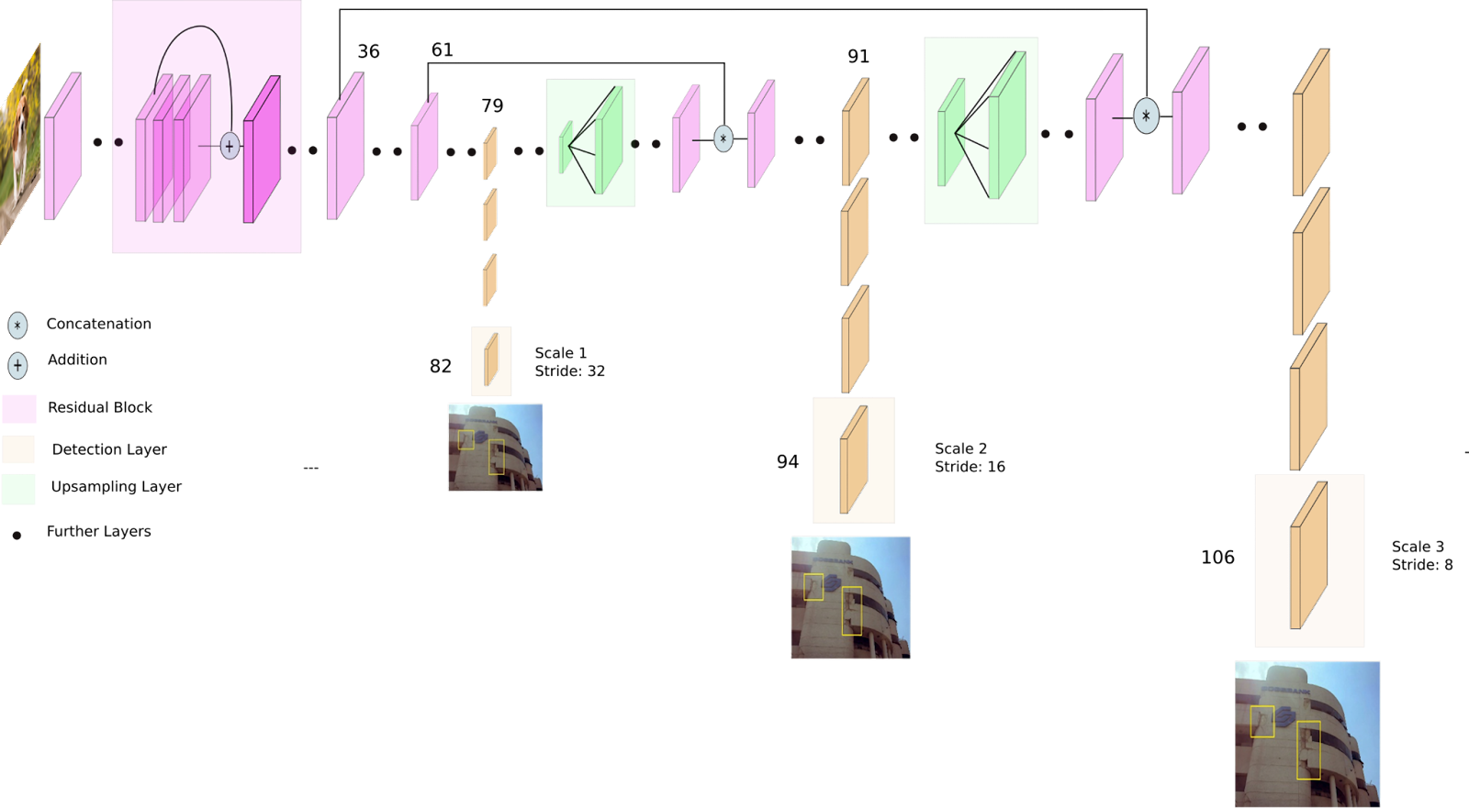
Learning environment
Layer architecture

Slide 15
Why do we use YOLOv3?
Layer architecture

Slide 16
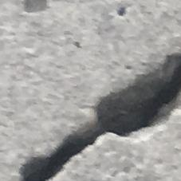
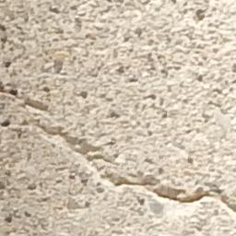
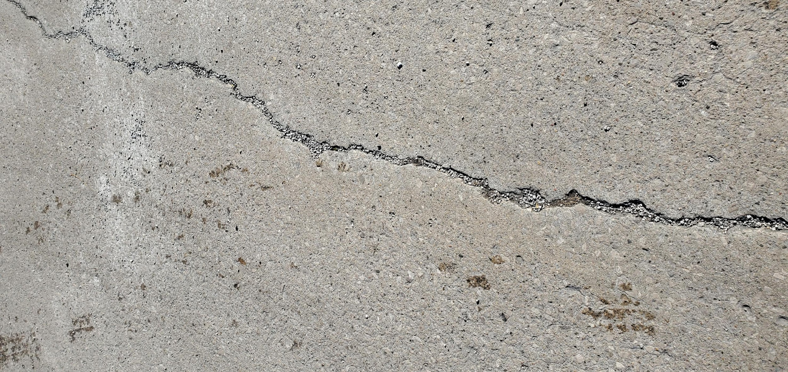
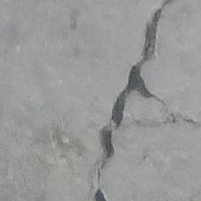
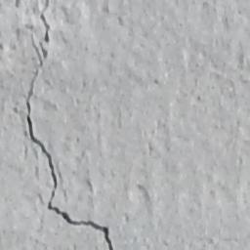
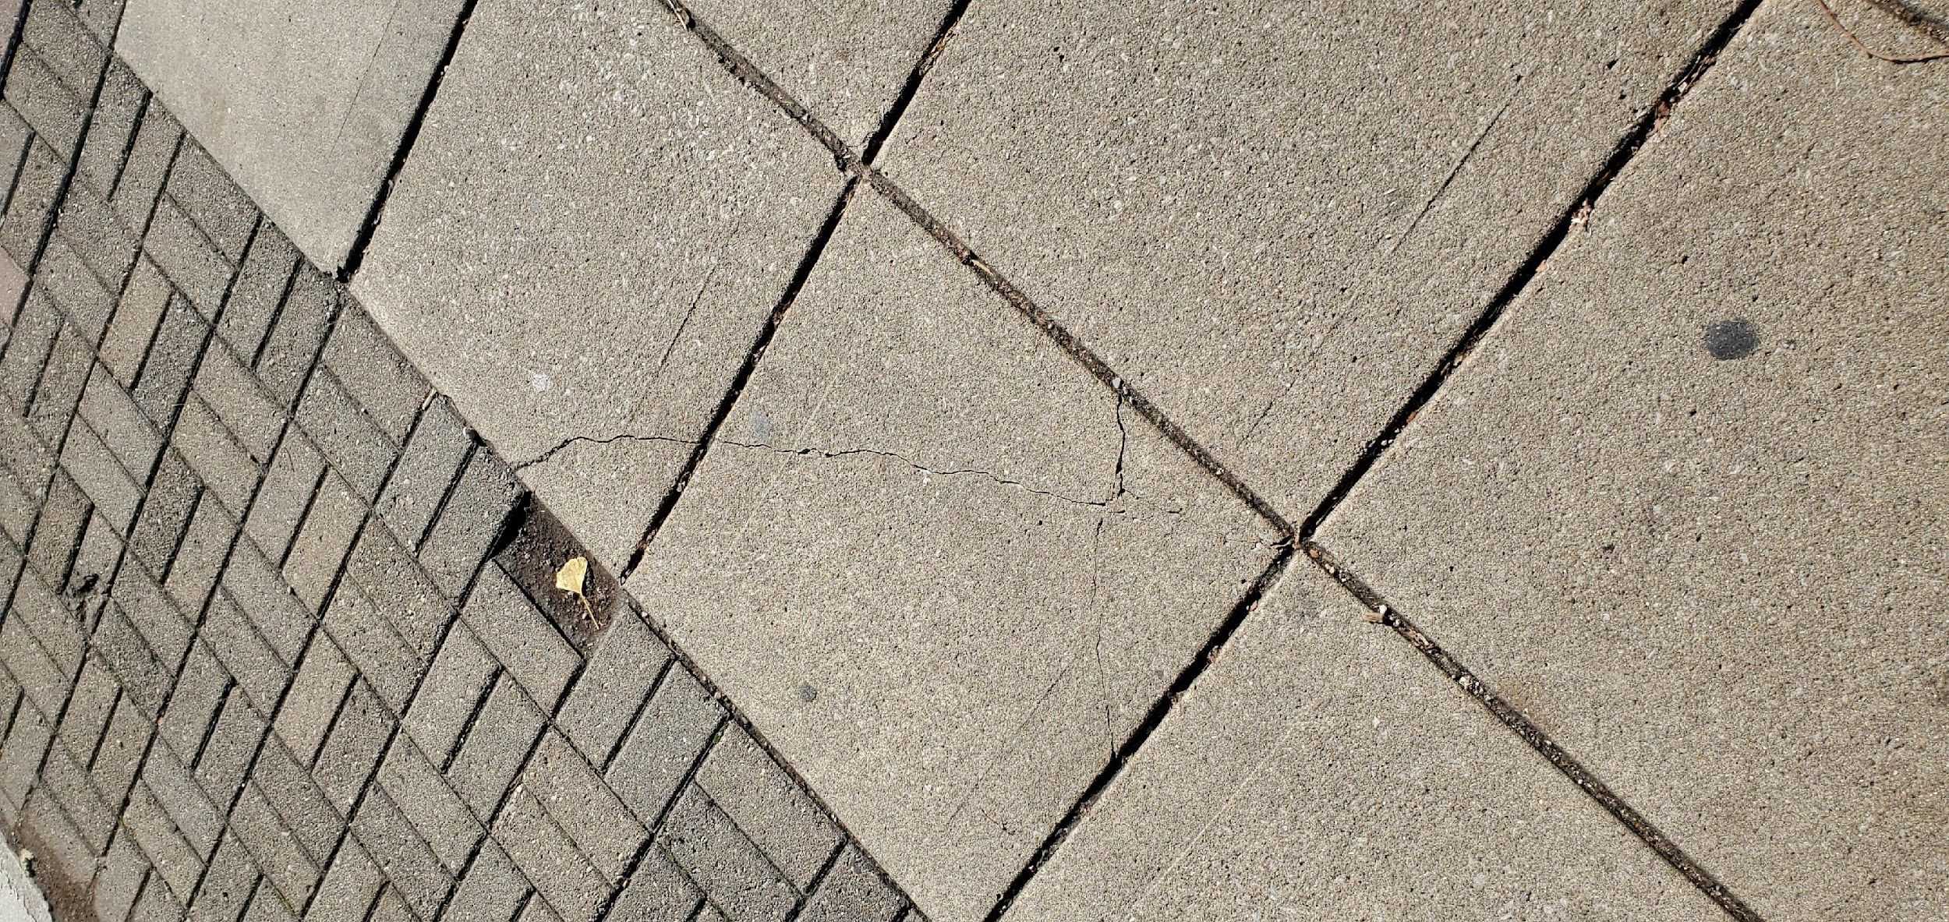
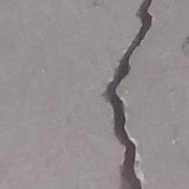
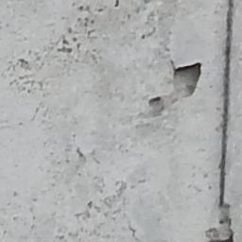
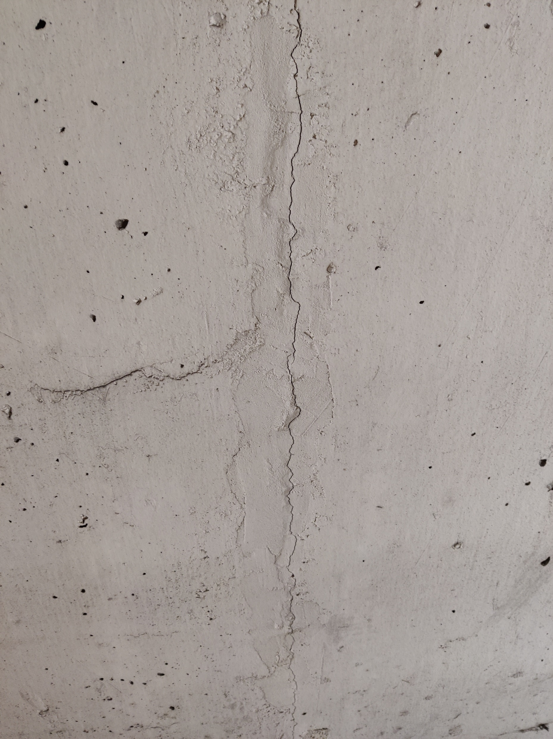
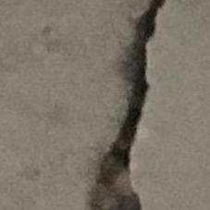
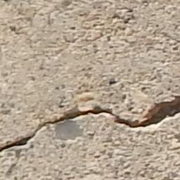
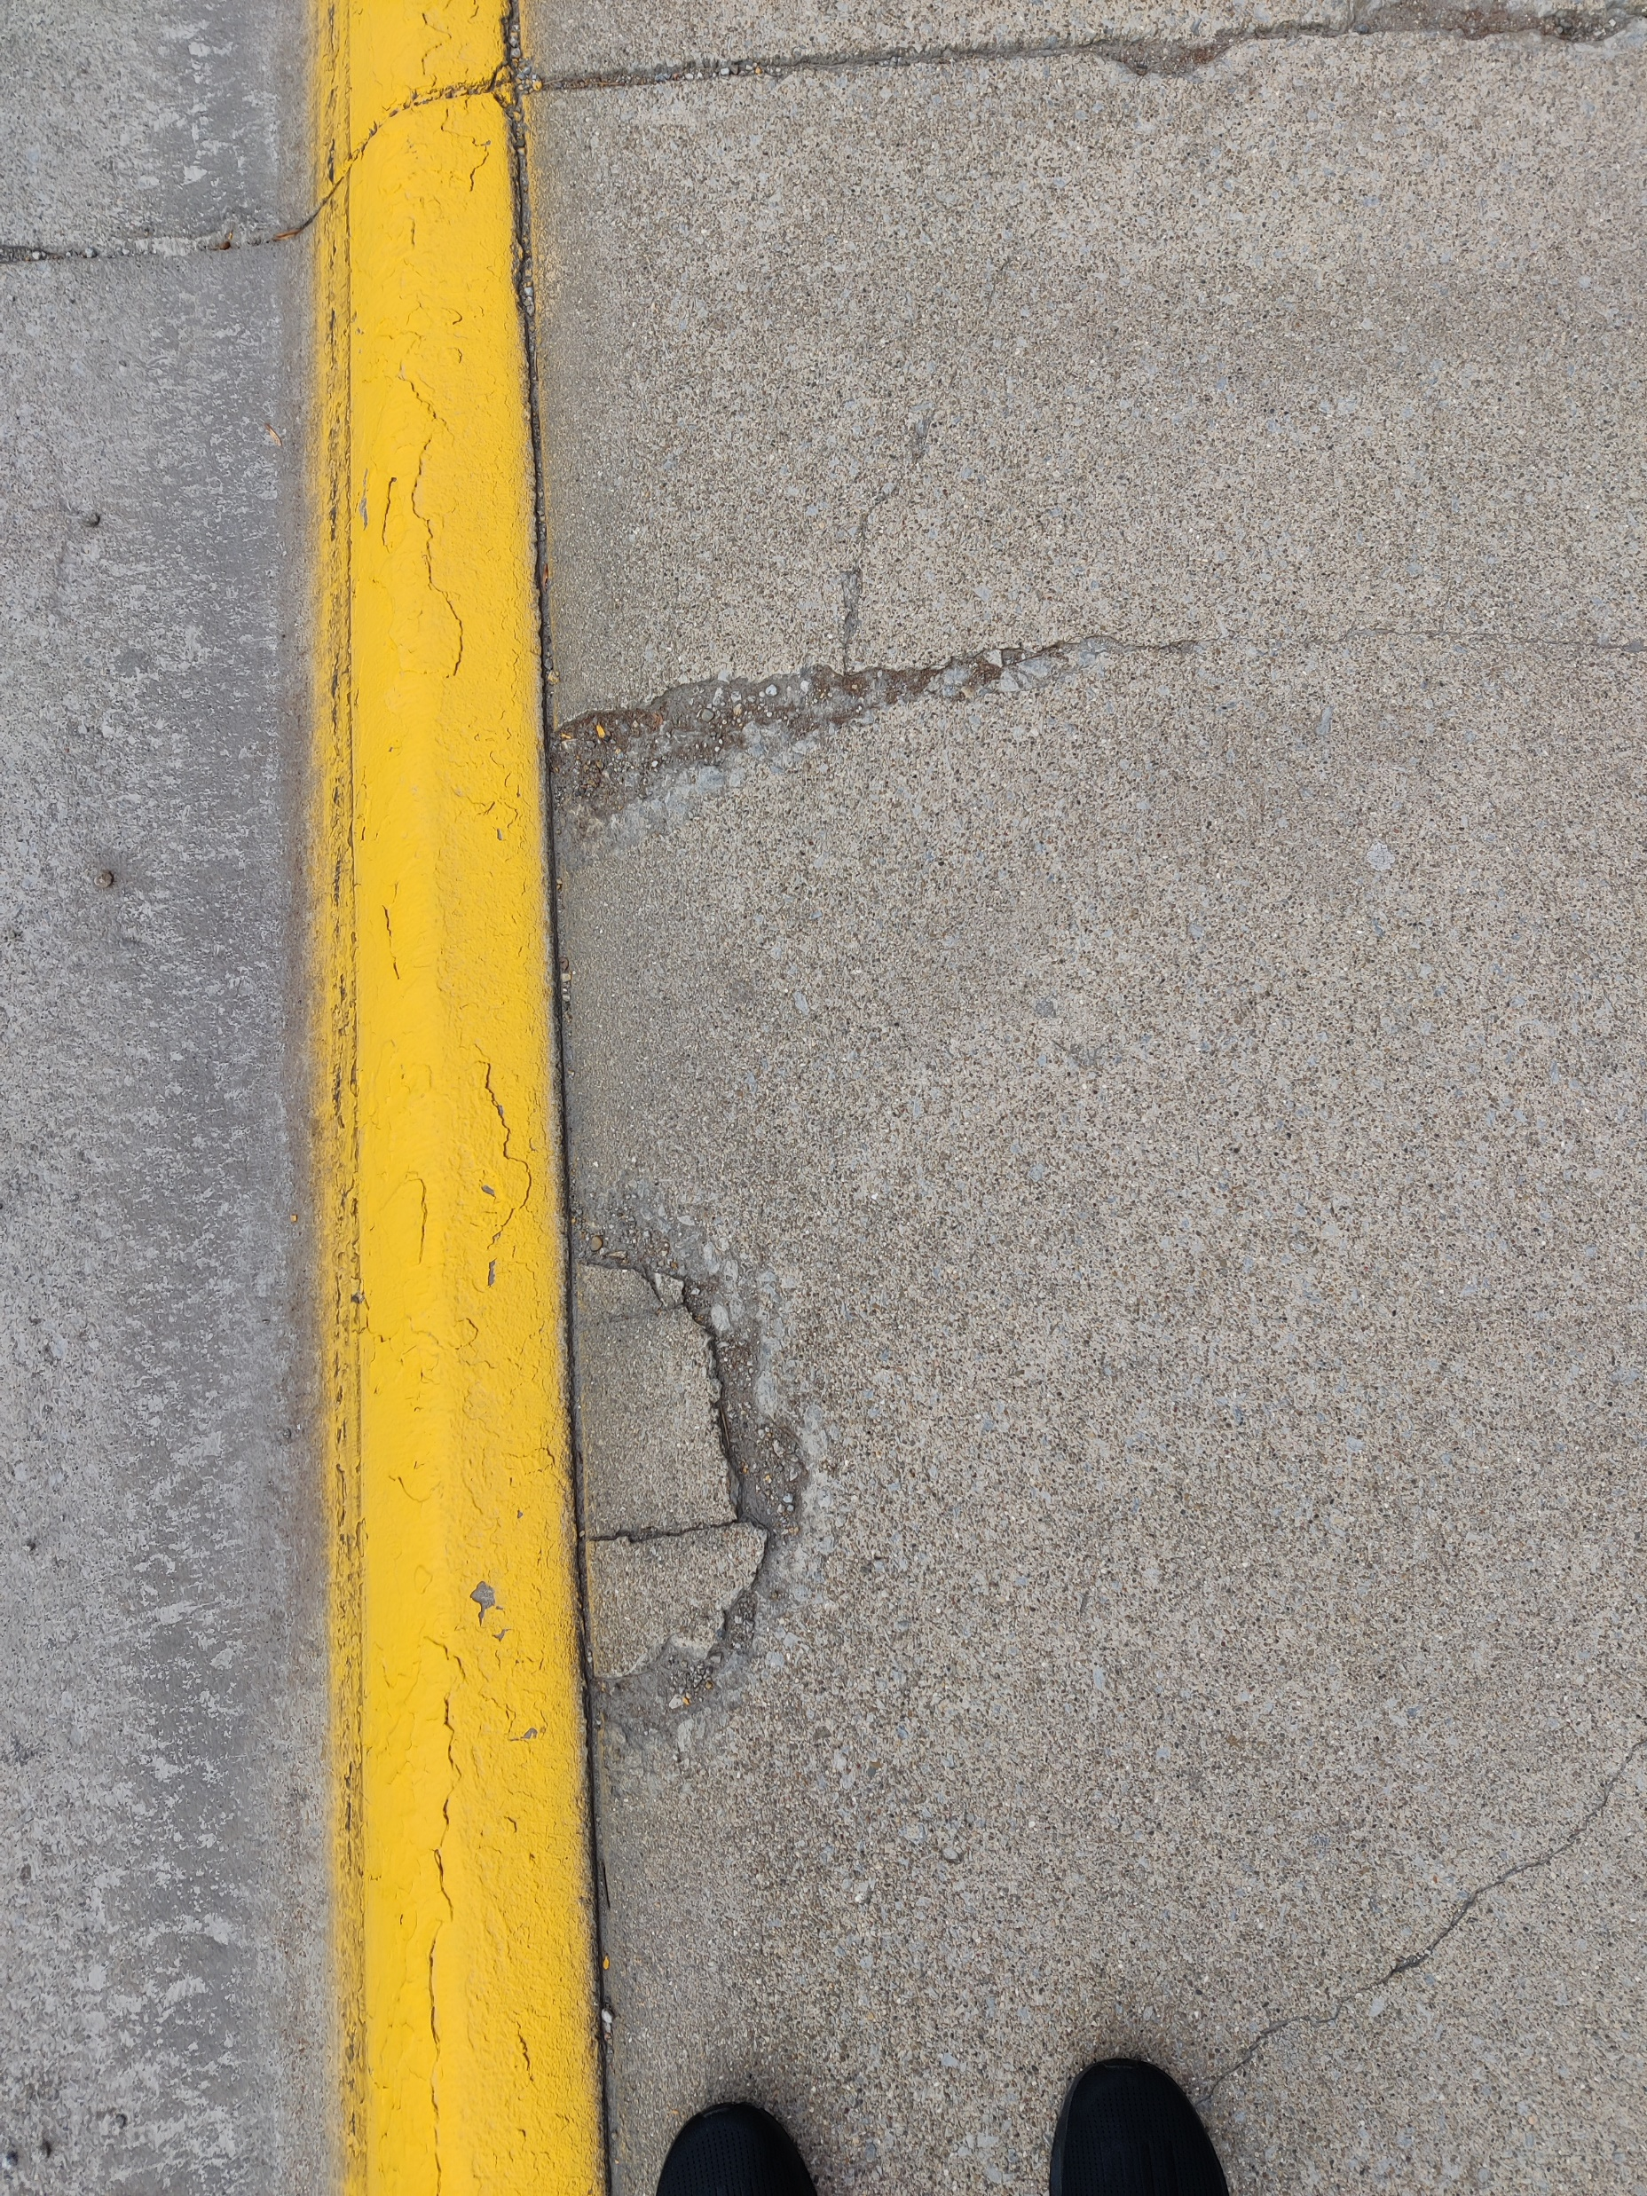
Dataset
A dataset that considers various environments and conditions in which cracks are photographed.
Used 9000 mixed images from METU, SDNET and Custom data.
METU
SDNET
CUSTOM

Slide 17

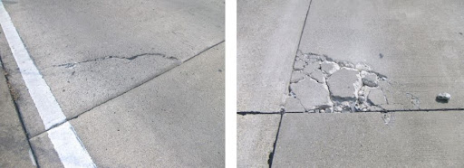
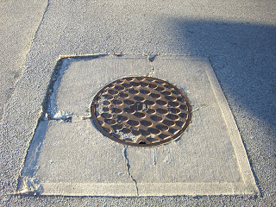
Experiment
Data labeling

Slide 18
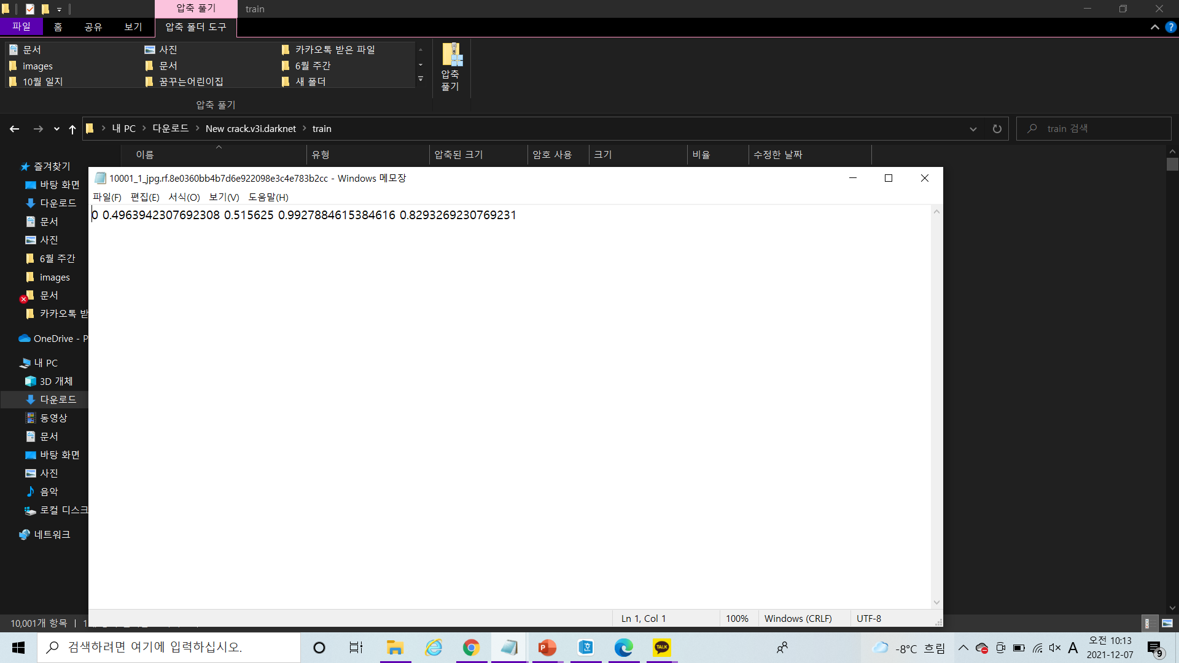
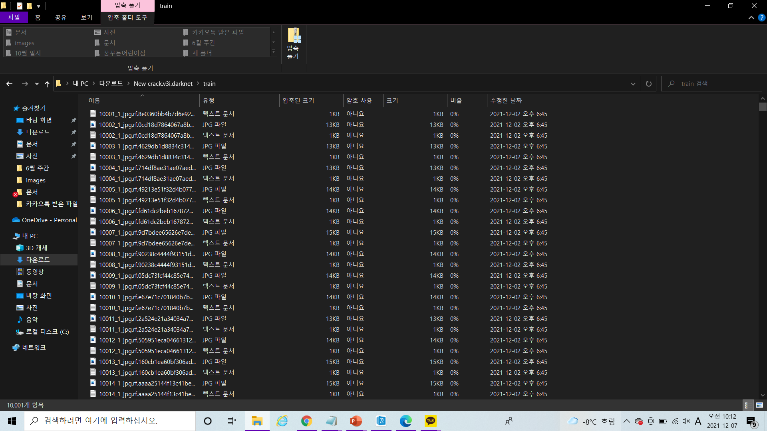
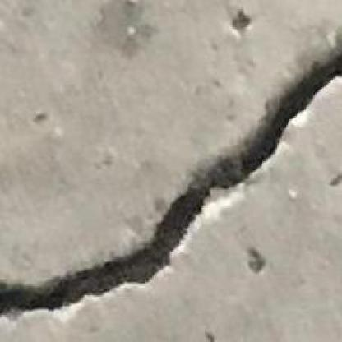
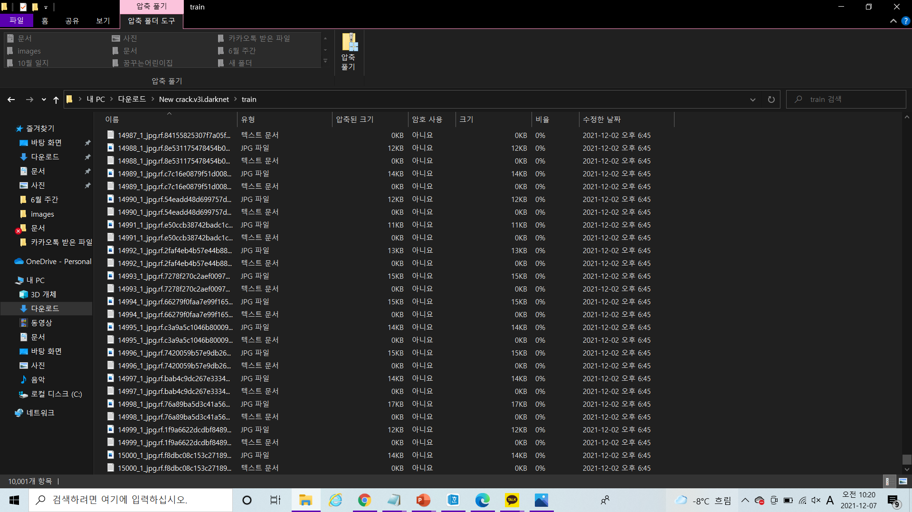
Experiment
Data labeling
<Text file>
~
<Image file>

Slide 19

Experiment
Data processing

Slide 20
2. EXPERIMENT

Slide 21
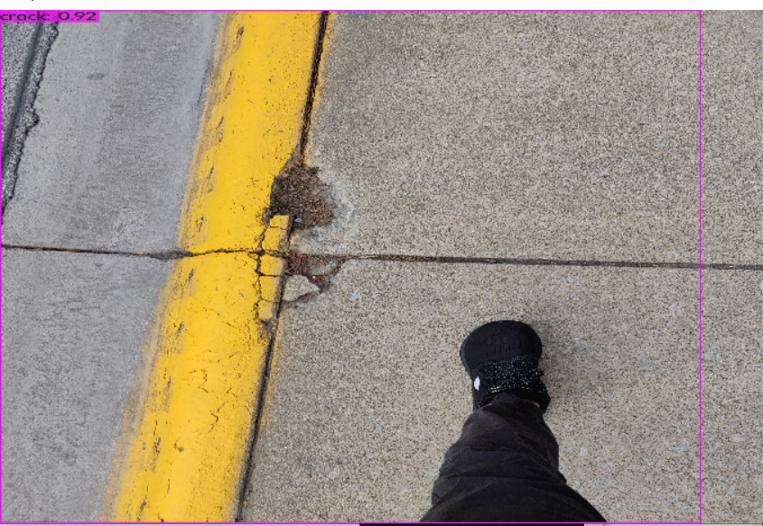
Experiment
1st model
Notes:
Our first model was trained with 2,200 METU datasets.
This model’s average data loss rate was low.
As you can see,
It can detect a few cracks.
There is no phenomenon that detects other objects as a crack.

Slide 22
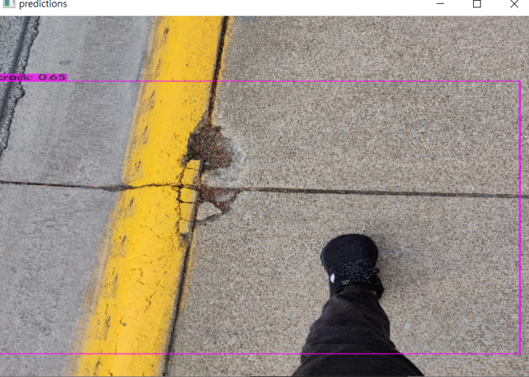
Experiment
2nd model
5,600 images of the METU dataset were trained on the second model.
It detects not only cracks but other objects like walls, concrete, and even humans as a crack.
It seems that the model trains common and biased characteristics of cracks, so there is a possibility that the model is overfitted.
A phenomenon in which the model is trained closer to the distribution of training samples than to the actual distribution is overfitting.
Can prevent this overfitting with regularization.
Notes:
The second model was trained with 5600 METU datasets.
This model detects not only cracks but also walls, concrete, and even people.
It seems to be a model that trains common and based characteristics for cracks.
And there is a possibility that the model will be overfit.
Overfitting is a phenomenon in which a model is trained closer to the distribution of a training sample than the actual distribution.
Overfitting can be prevented by normalization.

Slide 23
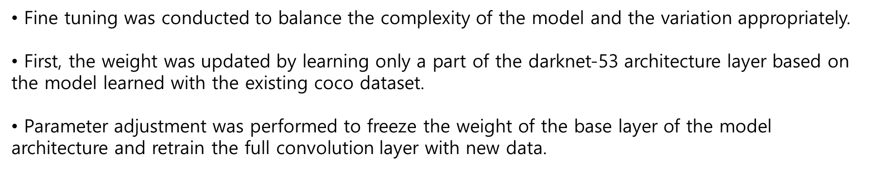
Experiment
Fine-tuning

Slide 24
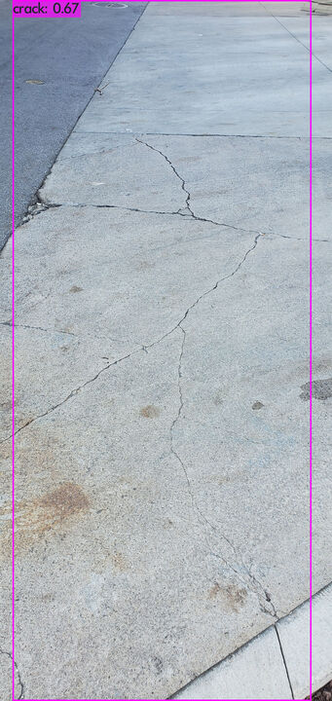
Experiment
3rd model
Third model trains 9,000 images of mixed METU datasets which are not on concrete, SDNET and custom datasets which we take a photo on concrete structures, sidewalks.
Its average data loss rate is kept lower and there is no phenomenon that detects other objects as a crack.
But performance of the model is not as good as the first model.
Notes:
The last model was trained with 9,000 METU, SDNET, and CUSTOM datasets.
This model includes photos of sidewalks and cracks in concrete buildings.
This keeps the average data loss rate low and does not detect other objects as cracks.
However, the performance is not as good as the first model.

Slide 25
Demo video
VIDEO
Notes:
I'll show you our demo video.

Slide 26
3. CONCLUSION
Notes:
Next is conclusion.

Slide 27
Conclusion
Improvement
The first solution moving forward is fine tuning by adjusting loss rate and accuracy in weight file which is utilized at darknet-53, repeating training to find the optimal values of loss rate and accuracy.
The second solution would be to collect more datasets that have different shapes as current models learn a lot of cracks that have similar shapes which can make models overfitted.
Notes:
I'll talk about the Improvement.
The first solution is to repeat the training to find the optimal value of the loss rate and accuracy by adjusting the loss rate and accuracy in the weight file utilized in the Darknet-53.
The second solution is to collect more data sets of different shapes as the current model can learn a lot of cracks in similar shapes and overfit the model.
If we use this solution, our model will be much better.

Slide 28
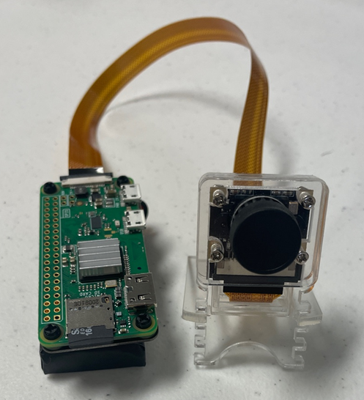
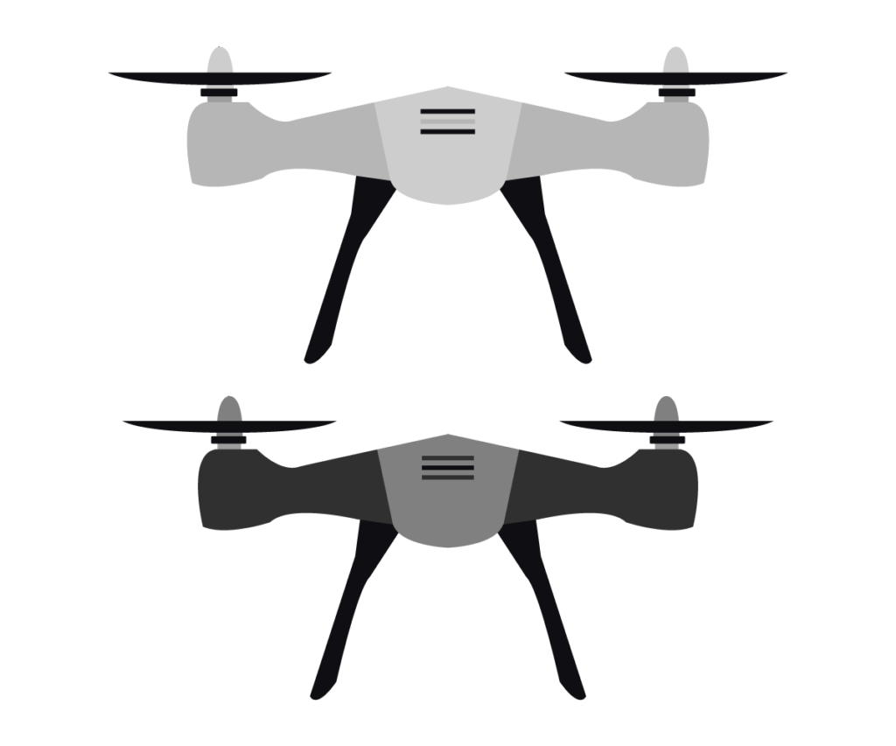
Conclusion
Future-plans
https://littledeep.com/drone-illustration/
Notes:
Lastly, it's our future plan.
We will use Raspberry Pie, Raspberry Pie Camera, and UAV to detect cracks in real time.
This reduces the time and cost of detecting cracks.
Cracks in locations that humans cannot detect can also be detected.

Slide 29





Conclusion
Future-plans
https://www.flaticon.com/free-icons
Notes:
And we will make our own CRACK MANAGEMENT SYSTEM.
Save detected cracks in real time on the server and classify them according to damage.
If a serious crack is found among them, notify the administrator immediately.
This makes building management easier and faster.

Slide 30
Thank you

Slide 31
Q & A

